Slide 1
THE BEGINNING OF ARTIFICIAL INTELLIGENCE
From Human Evolution to Silicon Minds

Slide 2

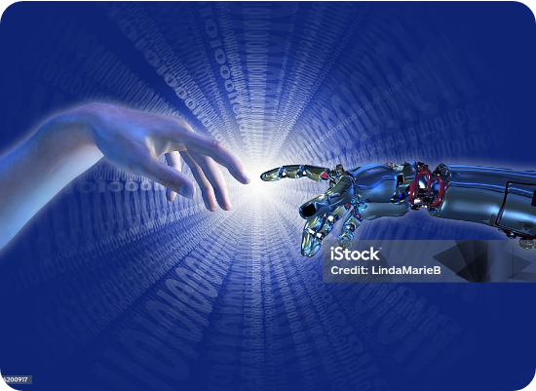
THE QUEST
HUMANS HAVE ALWAYS DREAMED...
For thousands of years, we've looked at ourselves and our own reflection, asking: Can we create something as brilliant as ourselves?
This isn't just about computers. It's about the journey of humanity trying to build a mirror for the mind.

Slide 3
CHAPTER ONE
HUMAN INTELLIGENCE
Why are we the dominant species on Earth?

Slide 4
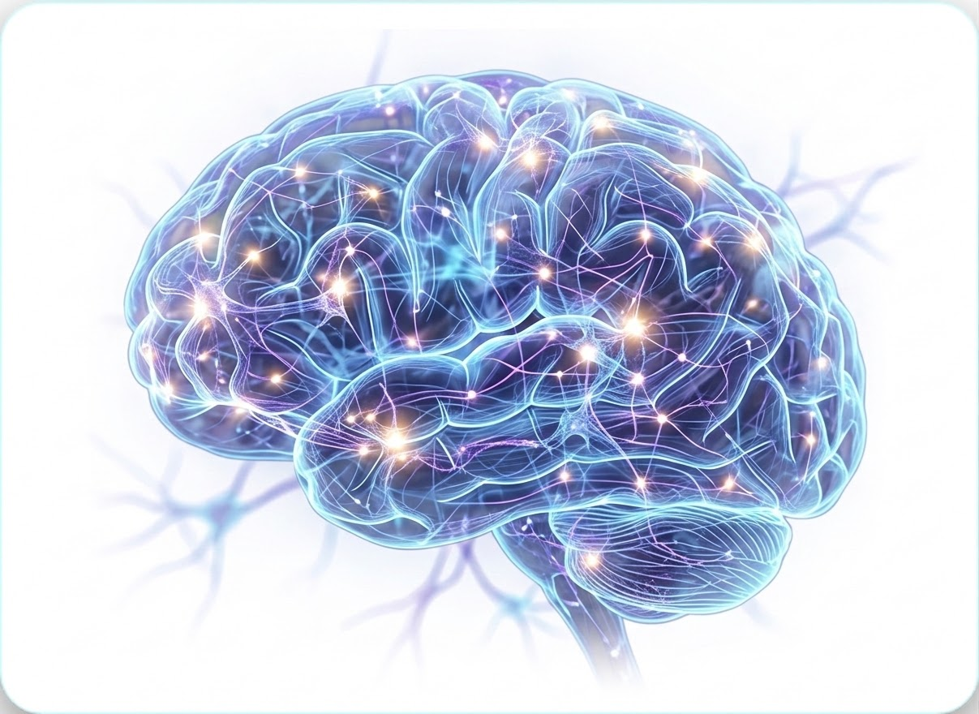
WHAT IS INTELLIGENCE?
Intelligence isn't just about knowing facts. It is the ability to:
Learn: Absorbing new information.
Adapt: Surviving in new environments.
Reason: Solving complex problems.
Remember: Using history to guide the future.

Slide 5






THE INTELLIGENCE LOOP
How a child learns, how a doctor heals, and how a pilot flies—all follow one cycle.
If this loop is so powerful, can we build it into machines?

Slide 6
THE DREAM OF ARTIFICIAL MIND
Humanity's first attempts at mechanical thoughts.

Slide 7
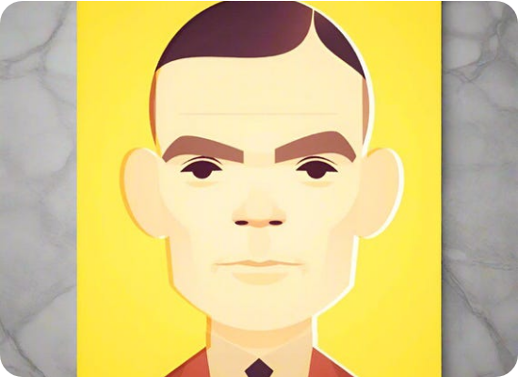
MILESTONES OF THE DREAM
ALAN TURING (1950)
"Can machines think?" - This question changed everything. Turing envisioned a machine that could mimic any human response perfectly.
DARTMOUTH (1956)
The term "Artificial Intelligence" was born. A group of scientists gathered to spend a summer trying to solve intelligence in two months. They were wrong about the time, but right about the vision.

Slide 8
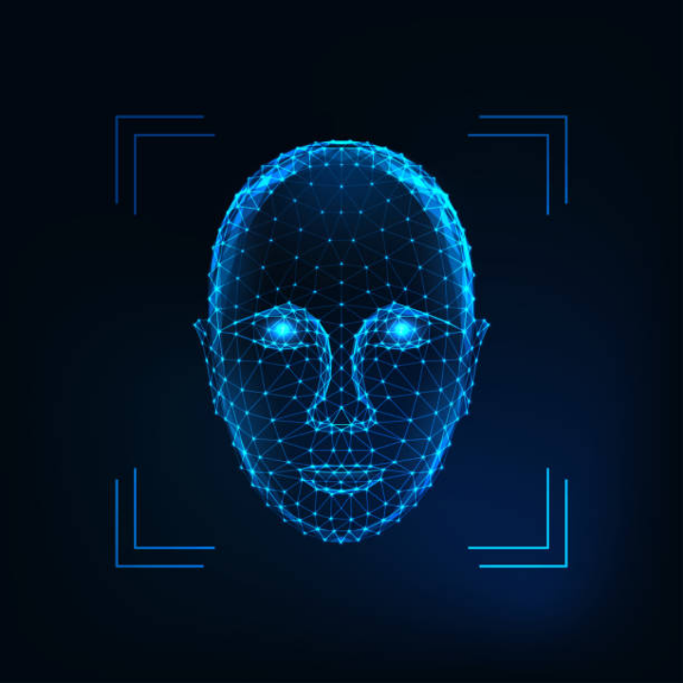

WHAT IS AI?
In the simplest terms, Artificial Intelligence is machines performing tasks that normally require human intelligence.
It's not just "one thing." It is a collection of tools that allow software to see, hear, talk, and decide and act
Visual Perception
Language Understanding
Conversation

Slide 9
CHAPTER THREE
THE GAP
Why today's AI isn't "True" intelligence... yet.

Slide 10




NARROW VS GENERAL
ANI (NARROW)
AGI (GENERAL)
Today's AI. It is an expert in ONE thing. A Chess AI cannot write a poem. A face-recognition system cannot drive a car.
Human-like AI. A system that can learn anything, adapt to any situation, and transfer knowledge from one domain to another.
Focused. Precise. Limited.
Versatile. Conscious. Hypothetical.

Slide 11
CHAPTER FOUR
THE REVOLUTION OF LEARNING
When we stopped giving orders and started giving examples.

Slide 12
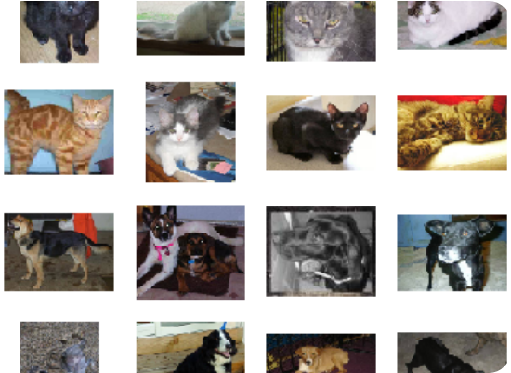
THE "CAT" PROBLEM
OLD PROGRAMMING:
If (Has Ears) AND (Has Whiskers) AND (Is Furry) THEN (It's a Cat).
Problem: What if the cat is behind a box? Or if it's a dog with whiskers? Handwriting every rule is impossible.

Slide 13
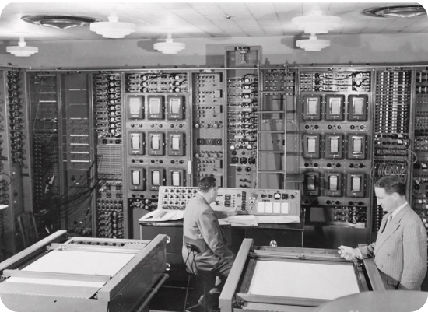
ARTHUR SAMUEL (1959)
Arthur Samuel built a checkers-playing program. He didn't teach it how to win; he taught it how to learn.
By playing thousands of games against itself, the program eventually beat Samuel himself. This was the birth of Machine Learning.

Slide 14







WHAT IS MACHINE LEARNING?
Learning patterns from data instead of following manual rules.
Spam Detection
Netflix Suggestions
Weather Prep

Slide 15



THE AI FAMILY TREE
ARTIFICIAL INTELLIGENCE
MACHINE LEARNING
DEEP LEARNING

Slide 16
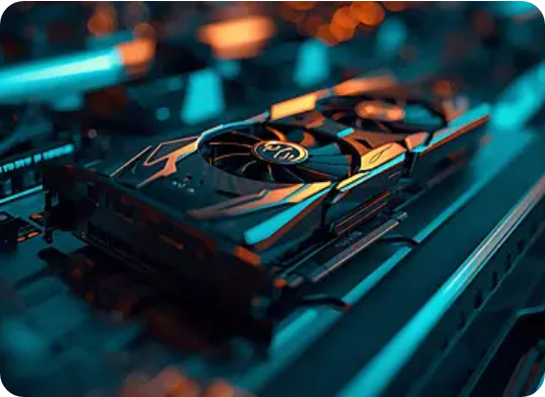

DEEP LEARNING: INSPIRED BY THE BRAIN
Deep Learning is a specialized type of ML. It uses Neural Networks—layers of connections inspired by human biology.
Input Layer (Pixels)
Hidden Layers (Pattern Recognition)
Output Layer ("It's a Cat!")

Slide 17





THE PERFECT STORM
AI existed in 1950. Why is it exploding NOW?
BIG DATA
POWERFUL GPUS
BETTER MATH
We finally have enough examples to teach machines.
Computing power that fits in our hands.
New algorithms discovered in the last 10 years.

Slide 18
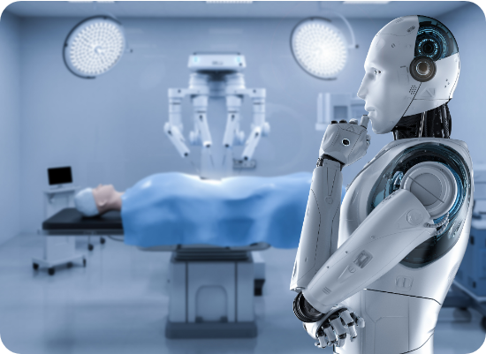
THE REVOLUTION IS HERE
AI is transforming every industry on Earth:
Healthcare: AI Diagnosing Cancer early.
Coding: AI assistants writing software.
Art: AI generating stunning images and text.
Science: AI predicting protein structures.

Slide 19
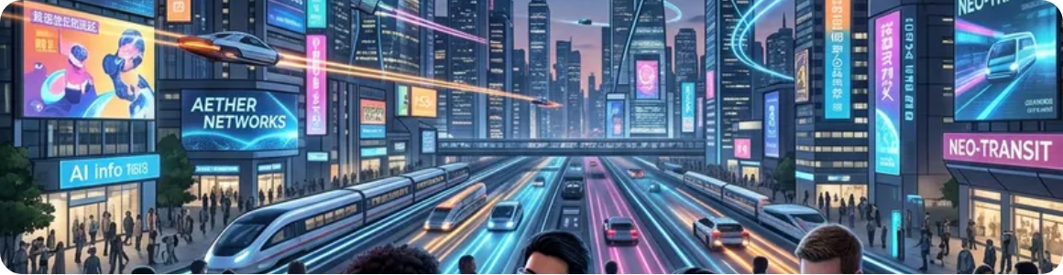

WHAT COMES NEXT?
Personalization
Discovery
Robotics
The AGI Horizon
Every student gets a personal AI tutor.
AI-powered robots helping in our homes.
True human-level reasoning machines.
AI discovering new clean energy sources.

Slide 20
YOU ARE ENTERING AT THE PERFECT TIME
The next generation of AI builders will not just use AI.
THEY WILL CREATE IT.
Don't just watch the future happen from the sidelines
Master the concept, build the brain, and become the architect of the new world.

